Slide 1


News website
News Prism
Session 2020 -2021
Techno India NJR Institute of Technology Udaipur (Raj.)
Computer Science

Slide 2
INTRODUCTION
About the project :-
This website is made for daily news update.
This website will help to provide most important news based on their functionality. News website is basically an online portal for new channel. They offer latest updates and notification on your device. There is various news portals present now a days.
Also presenting breaking news in a more timely manner.
Online news system allows customers to read up to date news related to many fields like Magazine, Business, Sports, Art, Politics, Travel, Breaking news, etc.
Without any payment or login. He can also contact us to give suggestions and can also give us feedback related to our site.

Slide 3
Functionality :-
· Magazine · Business · Sports · Art · Politics · Travel

Slide 4
Why we need to make this website?
• The main objective of this website is that to provide the all type of instant and important news related to Magazine, Business, Sports, Art, Politics, Travel, breaking news, etc.
• Manage the information of Magazine, Business, Sports, Art, Politics, Travel, Breaking news.
• Integration of all records of news.
• Those people who don’t have time to read the news paper and always linked with internet can get more informative.
• Publish news about local region, town and city, national and international. End user can upload news from anywhere at any time through web, mobile, tables, etc. with registered their login id and password.

Slide 5
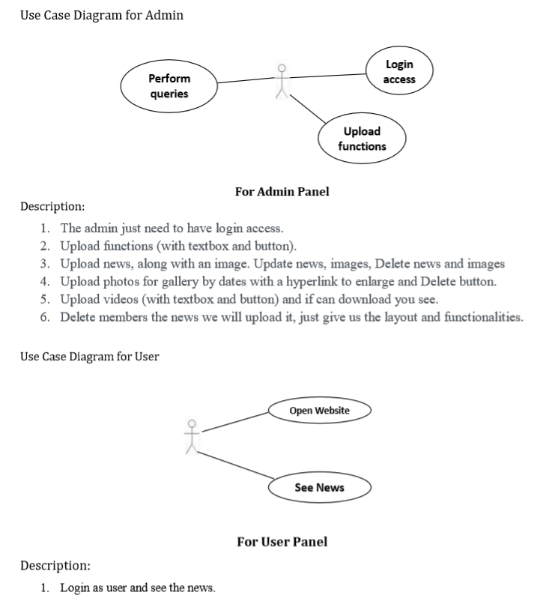
Project Design :
Use Case Diagram

Slide 6
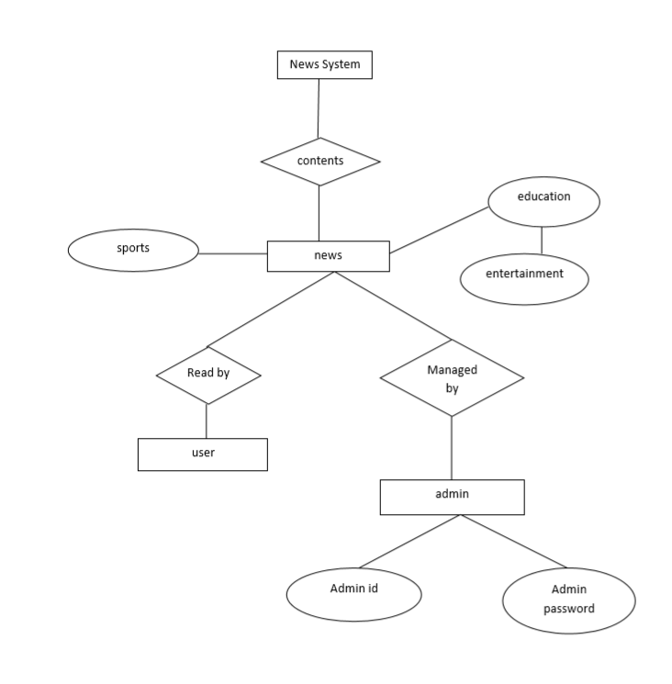
Entity-Relationship Diagram

Slide 7
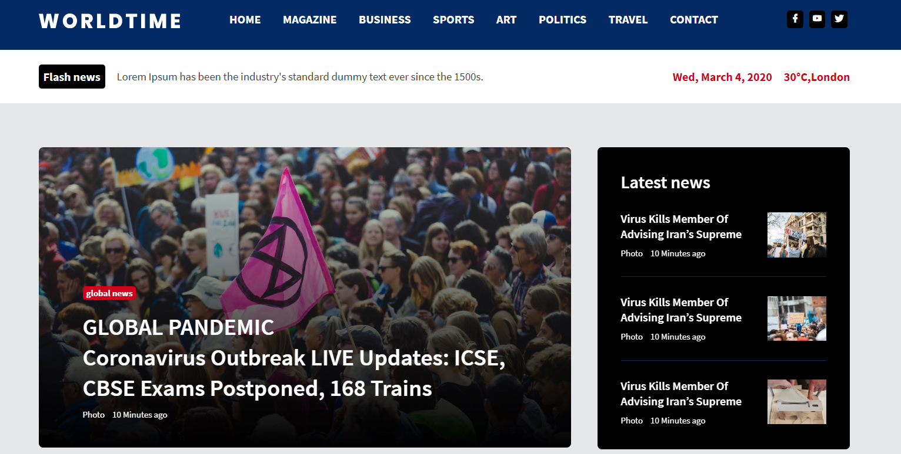
(1) The home page is the name of the main page of a website where visitors can find hyperlinks and functionality to find other pages.
(2)) Visitor navigating to a website from a search engine will see. And it may also serve as a landing page to attract visitors.

Slide 8
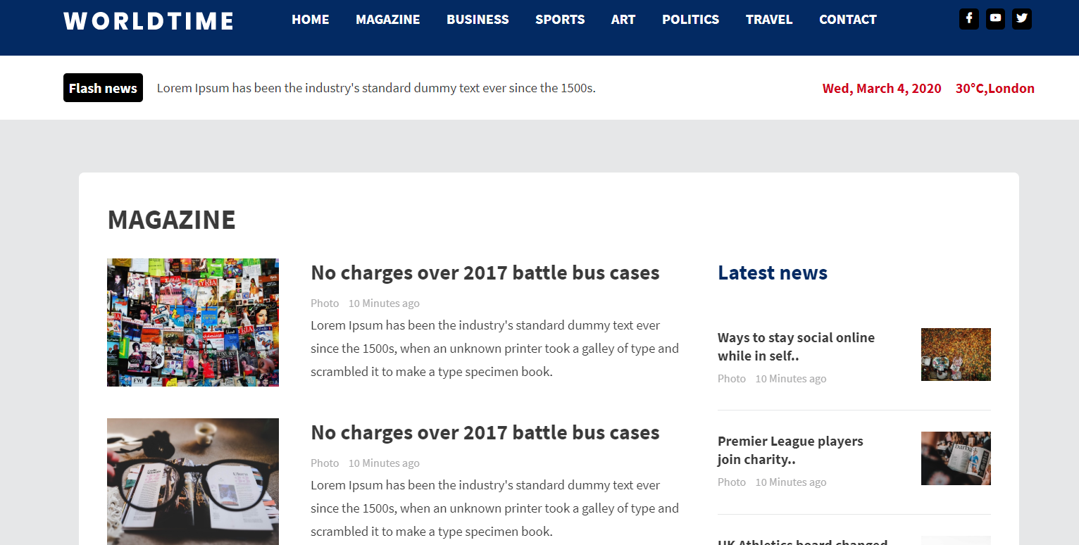
User Specification
Magazine Views

Slide 9
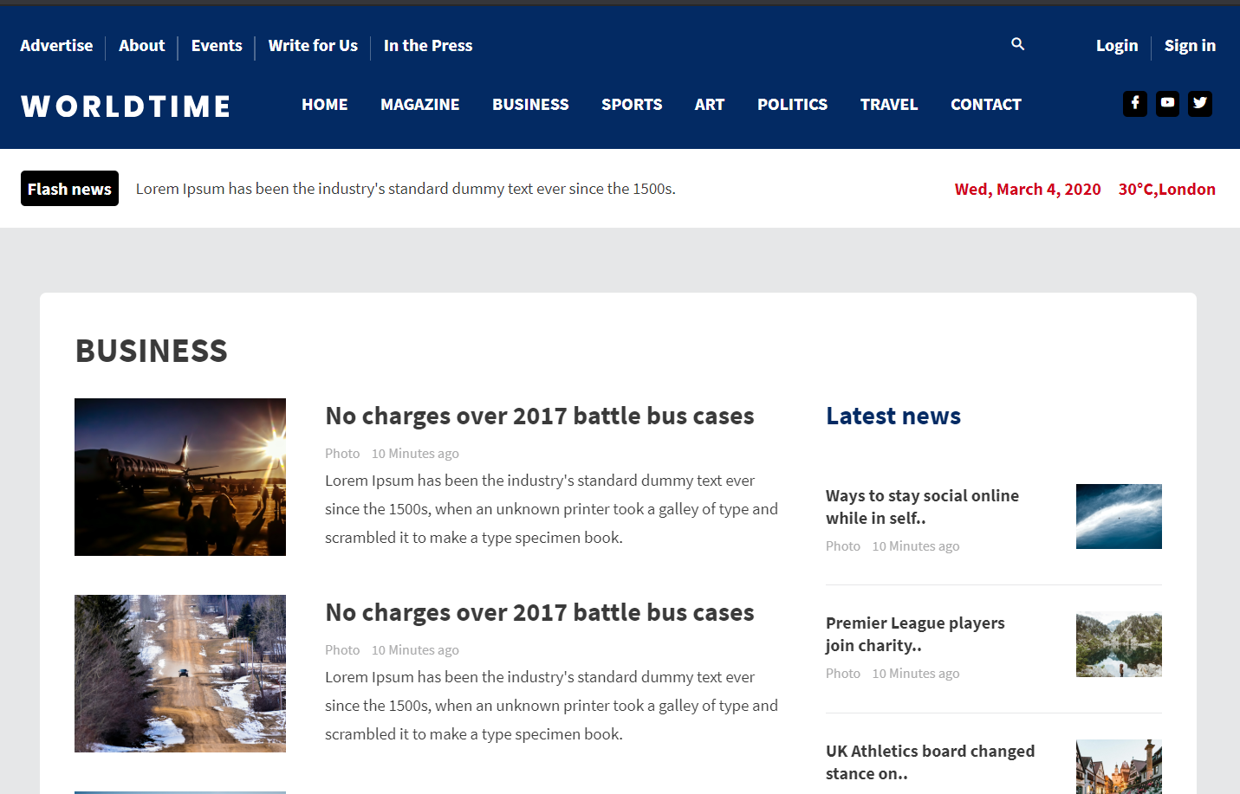
Business
Business News

Slide 10
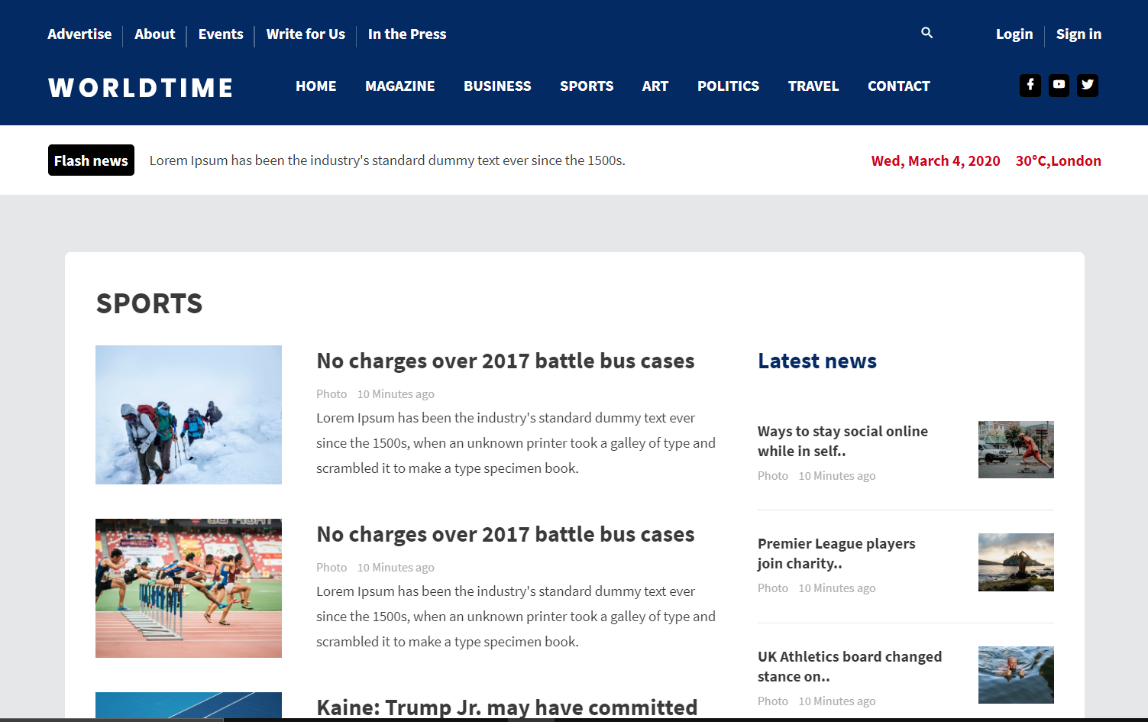
Sports
Sports News

Slide 11
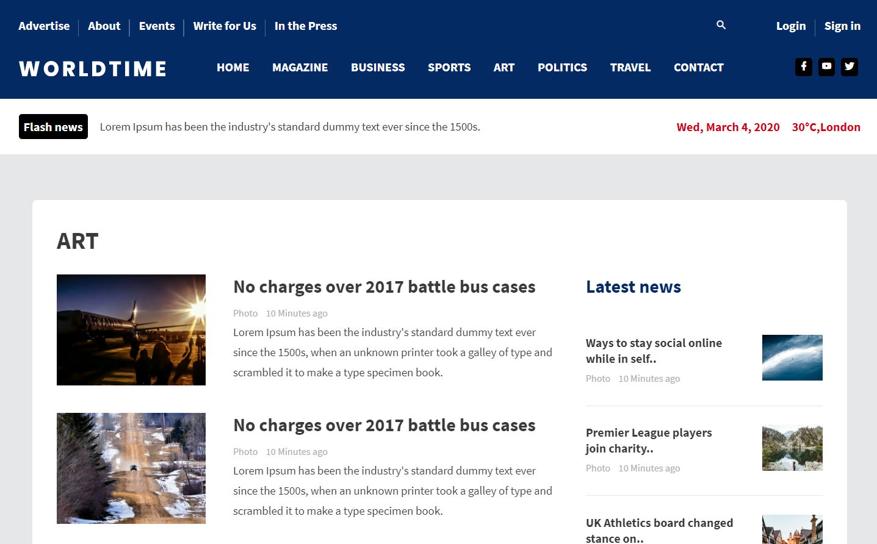
ART
Art News

Slide 12
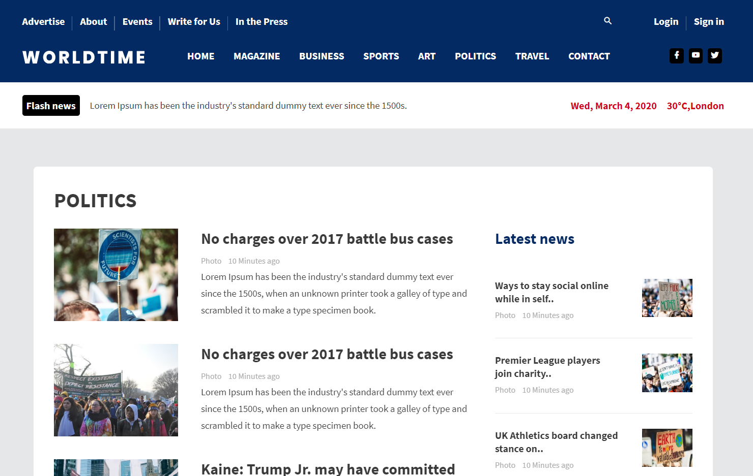
Politics
Politics News

Slide 13
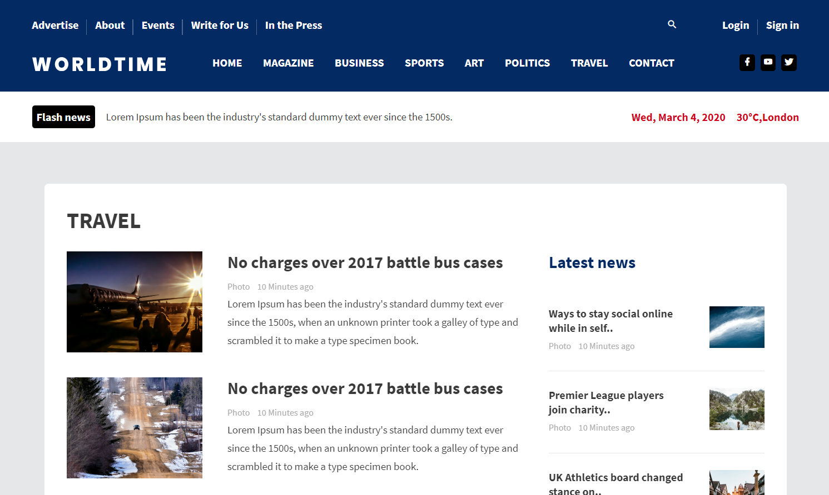
Travel
Travel News

Slide 14
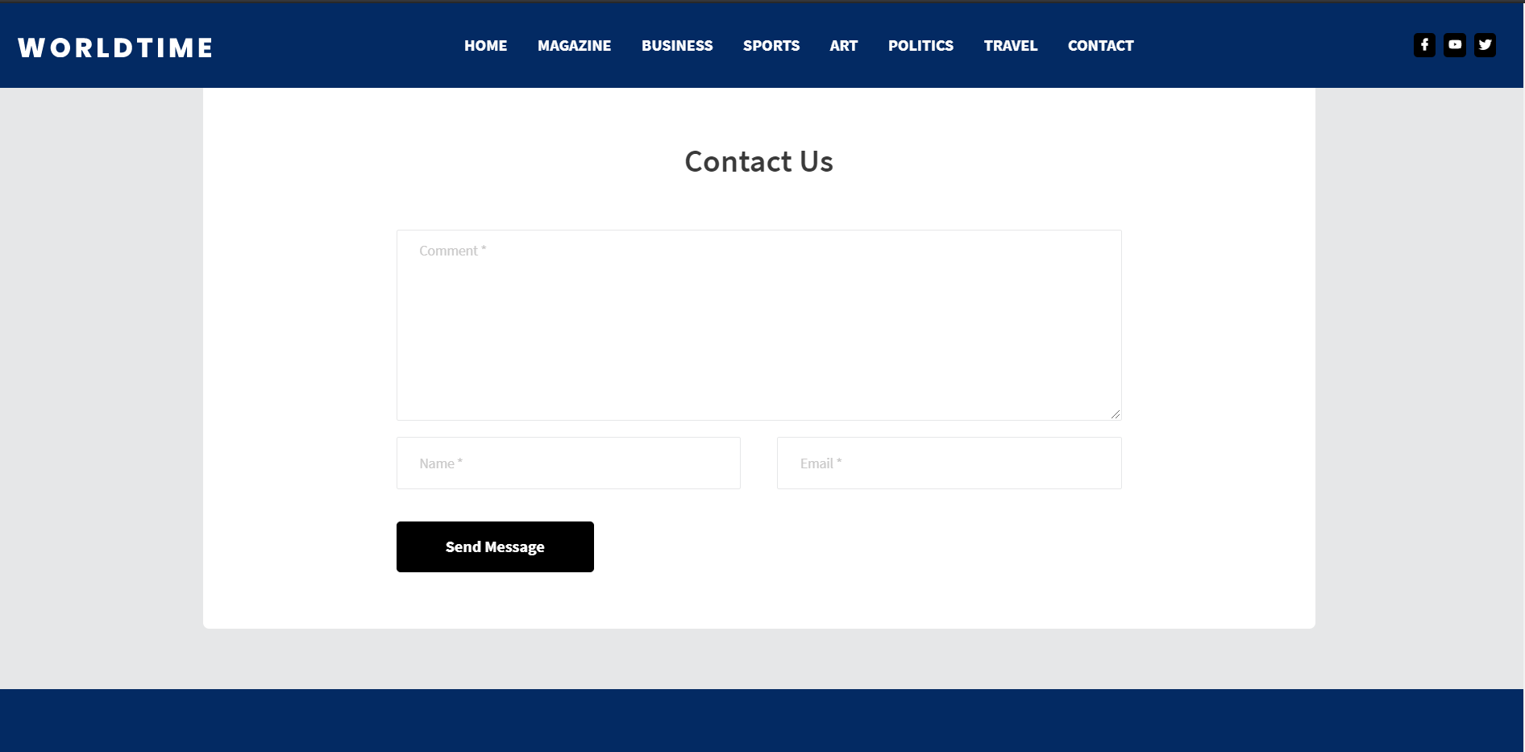
Contact Us
It could be beneficial to let your visitor decide what’s useful for them. It’s also helping the visitor to contact the website owner.

Slide 15
Merit and Demerits of the project
Merits:
• Extremely fast news
• Completely free
• No personal information required
• Interactive news
• Environmentally friendly
• Quick and easy way to get the news
Demerits:
• Not accessible in some part of the world.
• Difficult to navigate the internet.
• Only those person can use this website who know the basic computer knowledge

Slide 16
CONCLUSION
• To get information about current world ages anytime, anywhere, anyone can access by internet at low cost.
• Coverage of distribution and faster dissemination of information in a more timely manner.
• To provides a wonderful user interface that attracts more and more user.
• All new updated information that is more effective and useful for people.
• In our project work, an attempt has been made to develop a News or information based website. We develop this project that helps the people and make them aware so that they can know any news. To establish this website, we use various methodologies. To develop this project, we have faced many problems but we hardly tried to develop this project. Our training faculty helps us by giving his valuable opinion, decision and time.

Slide 17
FUTURE SCOPE
• The future scope is our project is valuable. In future if we get chance we will develop this website for large volume.
• As for other future developments, the following can be done :
➢ We update our database.
➢ We can make searching system more flexible.

Slide 18
Thank you
Submitted by:
Naresh Mali - (19ETCCS204)
Harshit Paneri - (18ETCCS041)
Ashish Jain - (19ETCCS200)

